Slide 1


Vincent Rammelsberg
October 6, 2025

Slide 2

Outline
Executive Summary
Introduction
Methodology
Results
Conclusion
Appendix

Slide 3
Executive Summary
Summary of methodologies
Data Collection through SpaceX API
Data Collection via Webscraping
Data Wrangling
Exploratory Data Analysis with SQL
Exploratory Data Analysis with Visualizations
Interactive Visual Analytics using Folium
Interactive Dashboard with Plotly Dash
Prediction of first stage landing outcome via Machine Learning models
Summary of all results
Average success rate of rocket launches increased between 2013 and 2020
Launch site KSC LC-39A has the highest success rate
Orbit types ES-L1, GEO, HEO and SSO have a 100% success rate
All launch sites are in proximity to a coast
Machine Learning models were able to accurately predict first stage landing outcomes (accuracy > 80%)

Slide 4
Introduction
Background
Questions
Our company SpaceY wants to use this information to bid against SpaceX for a rocket launch.
SpaceX advertises Falcon 9 rocket launches on ist website with a cost of 62 million dollars; other providers cost upward of 165 million dollars each.
much of the savings is because SpaceX can reuse the first stage.
Therefore if we can determine if the first stage will land, we can determine the cost of a launch.
Which factors impact the success rate of first stage landings?
Can we build a model that accurately predicts the first stage landing outcome?

Slide 5

Section 1

Slide 6
Methodology
Executive Summary
Data collection methodology:
Data collection through SpaceX API
Webscraping from a Wikipedia page
Perform data wrangling
Filter relevant data, handle missing values, apply OneHotEncoding to categorical features
Perform exploratory data analysis (EDA) using visualization and SQL
Perform interactive visual analytics using Folium and Plotly Dash
Perform predictive analysis using classification models
Train and test multiple machine learning models
Tune hyperparameters of each model via GridSearch

Slide 7
Data Collection
Collect data through SpaceX API
Make a GET request to the SpaceX API
Decode response content using .json() & convert result into a dataframe using .json_normalize()
Webscraping to collect Falcon 9 historical launch records from a Wikipedia page
Perform an HTTP GET method to request the Falcon9 Launch HTML page
Use BeautifulSoup to parse HTML table & convert it into a Pandas dataframe

Slide 8
Data Collection – SpaceX API
The SpaceX API provides information about rocket launches done by SpaceX
Collect relevant data through the SpaceX API
We used GET-requests to several endpoints of the SpaceX API
https://github.com/vincentR2/IBM_DataScience_Capstone/blob/main/01_DataCollection_API.ipynb
GET request to SpaceX API
Decode and parse SpaceX launch data
Filter dataframe to only include Falcon 9 launches
Replace missing values in PayloadMass column with the mean
Convert data to a dataframe

Slide 9
Data Collection - Scraping
Perform web scraping to collect historical launch records from a Wikipedia page
https://en.wikipedia.org/wiki/List_of_Falcon_9_and_Falcon_Heavy_launches
https://github.com/vincentR2/IBM_DataScience_Capstone/blob/main/02_DataCollection_Webscraping.ipynb
Create BeautifulSoup object from HTML response text
Parse the HTML tables to fill a dictionary with relevant launch data
Use dictionary to create a dataframe
Request the Falcon9 Launch Wiki page from its URL
Extract all column names from the HTML table header

Slide 10
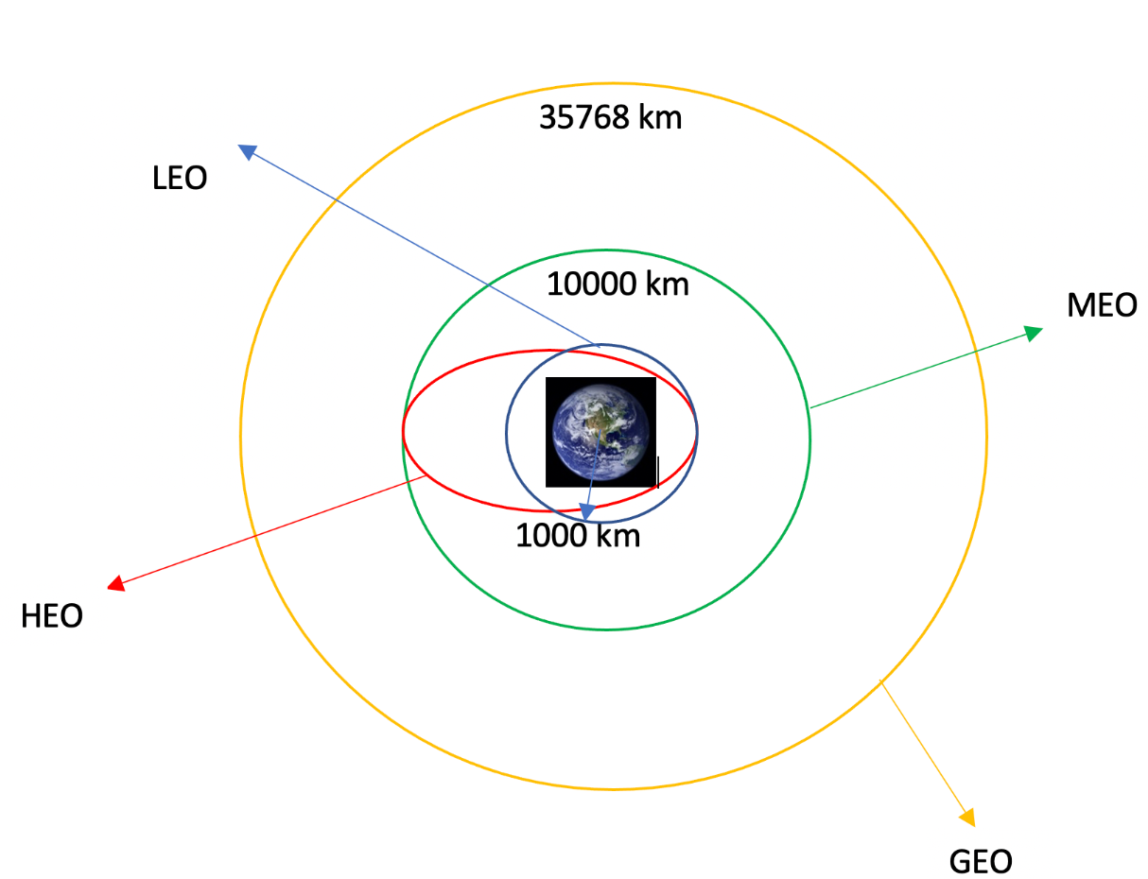
Data Wrangling
Perform some Exploratory Data Analysis (EDA) to identify patterns in the data
Determine number of launches per launch site
Determine occurrences of each orbit type
Data Wrangling
Convert outcomes of booster landings to a binary label
0: booster landing was unsuccessfull
1: booster landed successfully
Create dummy variables to categorical columns
https://github.com/vincentR2/IBM_DataScience_Capstone/blob/main/03_DataWrangling.ipynb

Slide 11
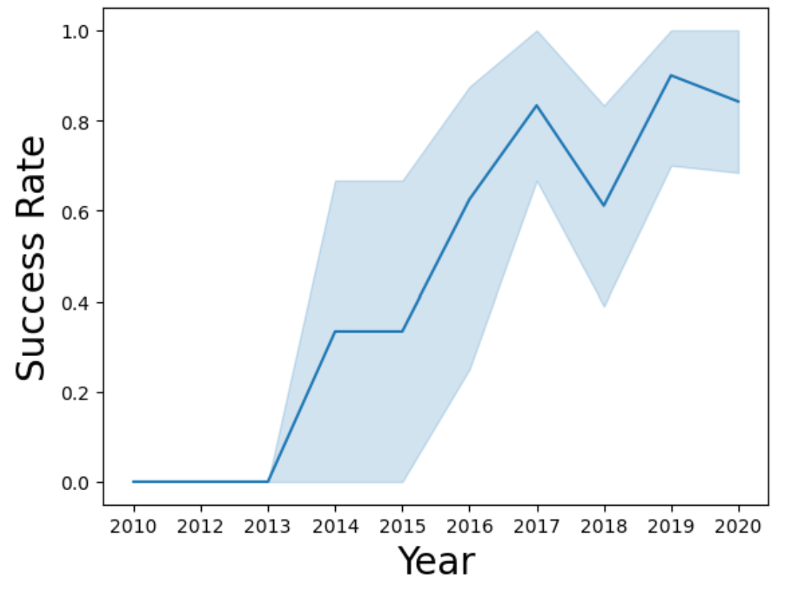
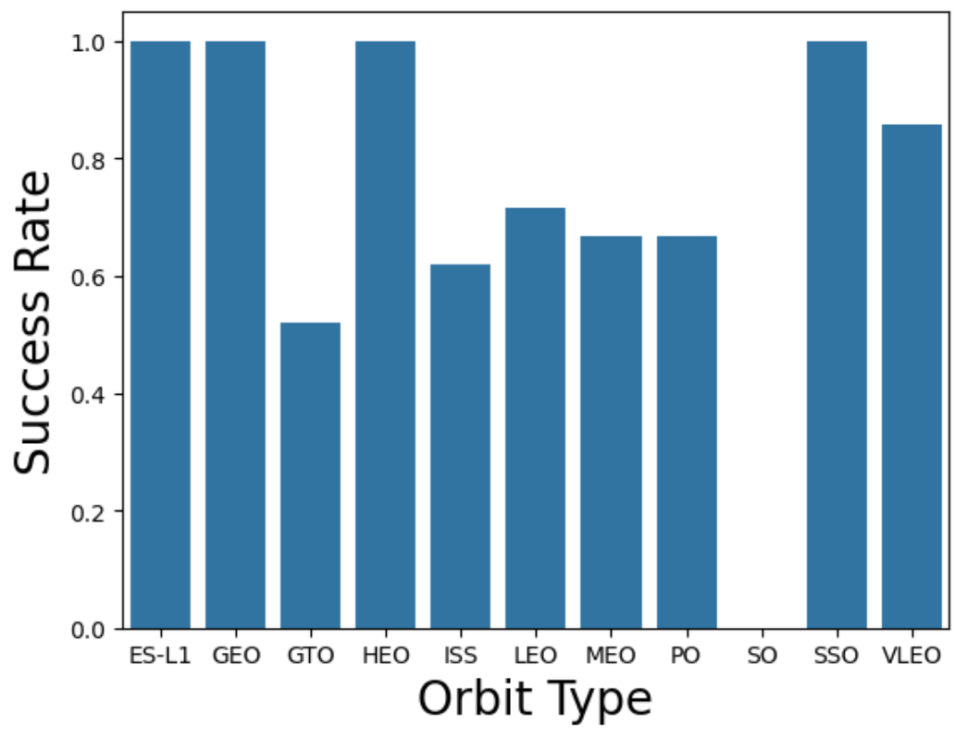
EDA with Data Visualization
Perform EDA with data visualizations to identify relationships between the features
Relationship between Flight Number & Launch Site
Relationship between Payload Mass & Launch Site
Launch Success Rate over the Years (->Lineplot)
Success Rate of each Orbit Type (->Barplot)
https://github.com/vincentR2/IBM_DataScience_Capstone/blob/main/05_EDA_DataVisualizations.ipynb

Slide 12
EDA with SQL
Load the SpaceX dataset into the corresponding table in a Db2 database
Execute SQL queries to gain insights about SpaceX launch data
Names of unique launch sites
Total payload mass carried by boosters launched by NASA (CRS)
Average payload mass carried by booster version "F9 v1.1"
Date of first successful landing outcome on ground pad
Total number of successful and failure mission outcomes
All booster versions that have carried the maximum payload mass
Count of landing outcomes between 2010-06-04 and 2017-03-20
https://github.com/vincentR2/IBM_DataScience_Capstone/blob/main/04_EDA_SQL.ipynb

Slide 13
Build an Interactive Map with Folium
Analyze the existing launch site locations with Folium
Add a marker for each launch site on the folium map
Identify locations of existing launch sites
Create colored-labeled markers for all launch records based on the launch outcome to identify launch sites with high success rates
Successful: green marker
Unsuccessful: red marker
Calculate the distances between a launch site and its proximities (e.g. railway, highway, coastline, closest city)
Draw lines between launch site and its proximities
https://github.com/vincentR2/IBM_DataScience_Capstone/blob/main/06_InteractiveVisualAnalytics_Folium.ipynb

Slide 14
Build a Dashboard with Plotly Dash
We build an interactive SpaceX launch records dashboard with Plotly Dash
Users can select the launch site and a range of payload mass to gain specific insights about SpaceX launch records
Pie Chart
Show the total successful number of successful launches for each all sites
Show the number of successful and failed launches for a specific site
Scatter Plot
Show the correlation between payload mass (x-axis) and launch success (y-axis)
https://github.com/vincentR2/IBM_DataScience_Capstone/blob/main/spacex-dash-app.py

Slide 15
Predictive Analysis (Classification)
We create a machine learning pipeline to predict if the first stage will land successfully or not
Standardize our dataset
Split our dataset into a training set (80%) and a test set (20%)
Train and finetune different machine learning models
Create machine learning model object
Create GridSearchCV object with different hyperparameter settings
Find model with the best hyperparameter combinations and determine the accuracy on the validation data
Test models on unseen test data
Calculate accuracy on test data & plot confusion matrix
https://github.com/vincentR2/IBM_DataScience_Capstone/blob/main/07_MachineLearning_Prediction.ipynb

Slide 16
Results
Exploratory data analysis results
Interactive analytics demo in screenshots
Predictive analysis results

Slide 17

Section 2

Slide 18
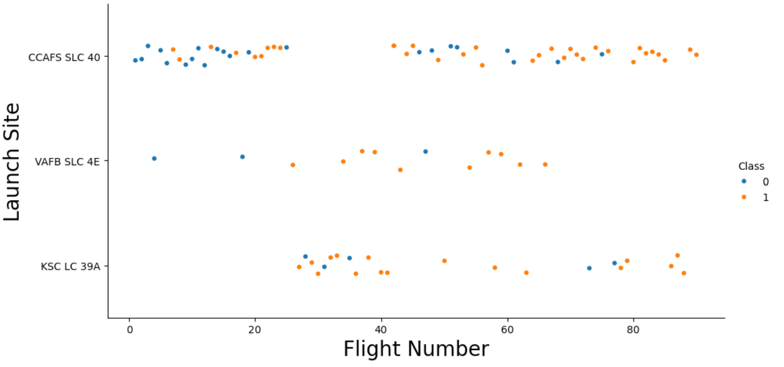
Flight Number vs. Launch Site
The scatter plot visualizes the relationship between flight number (x-axis) and launch site (y-axis)
Earlier flights had a lower success rate (more blue points)
It also visualizes the success rate and amount of launches of each launch site

Slide 19
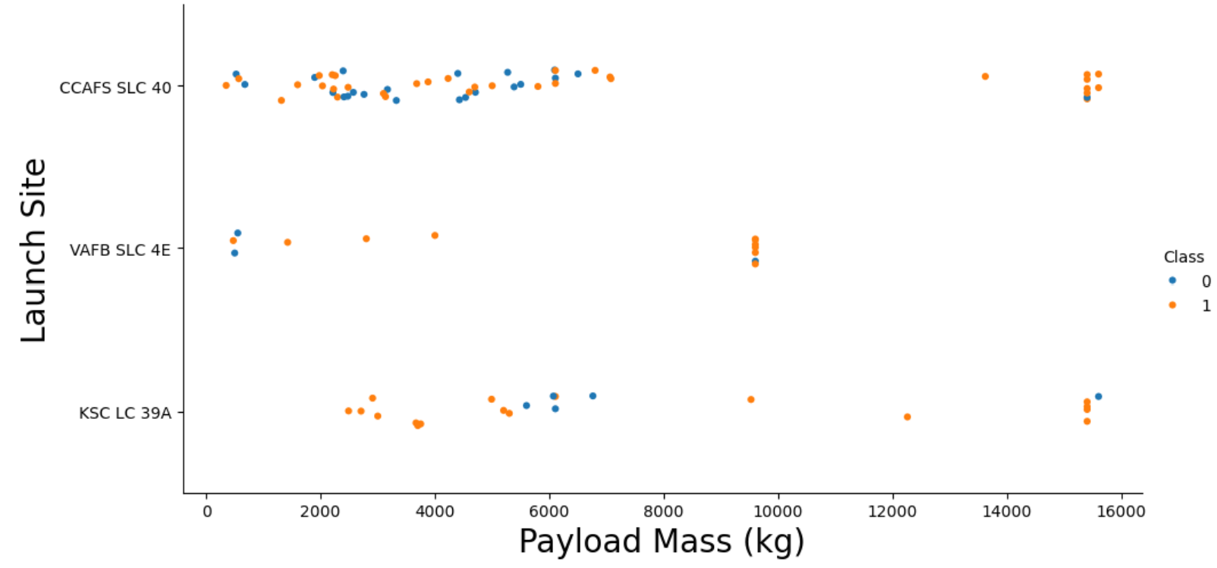
Payload vs. Launch Site
As payload mass increases, the first stage is more likely to land successfully
For launch site "VAFB SLC 4E" there are no rockets launched for heavy payloads (>10.000kg)

Slide 20
Success Rate vs. Orbit Type
Orbit Types ES-L1, GEO, HEO and SSO have a perfect success rate (100%)
SO has no successful rocket launches
Except for SO, every orbit type has a success rate higher than 50%

Slide 21
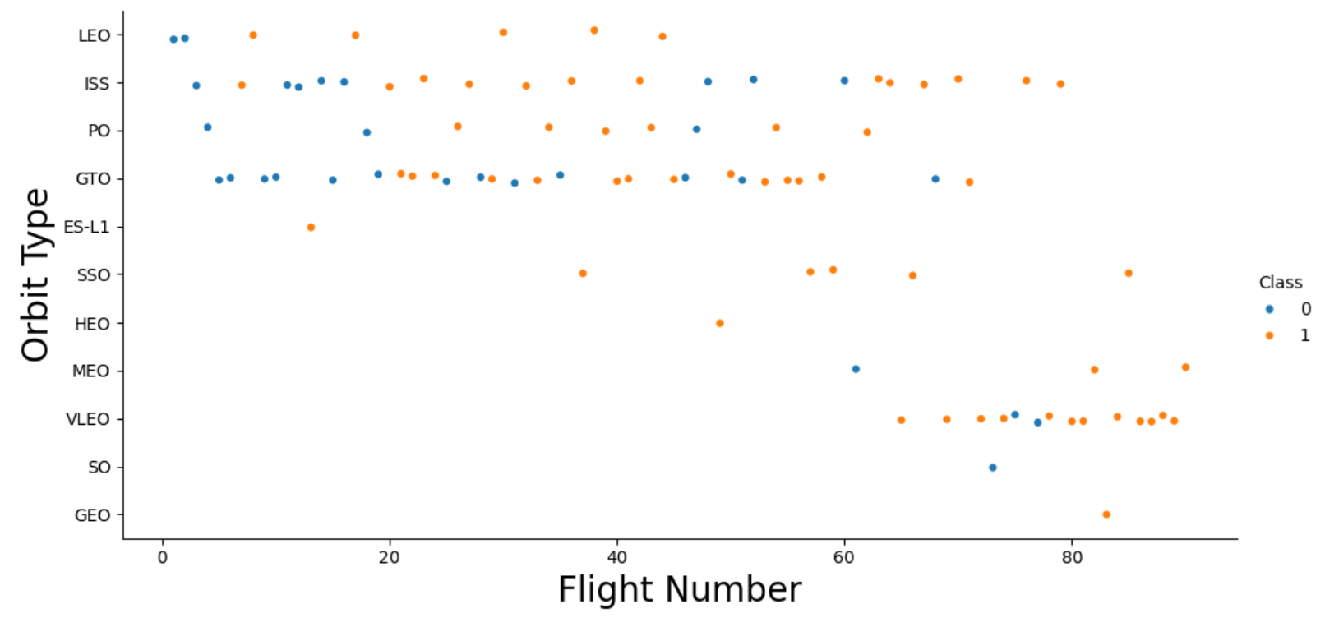
Flight Number vs. Orbit Type
In the LEO orbit, success seems to be related to the number of flights
Many orbit types are only represented in higher flight numbers

Slide 22
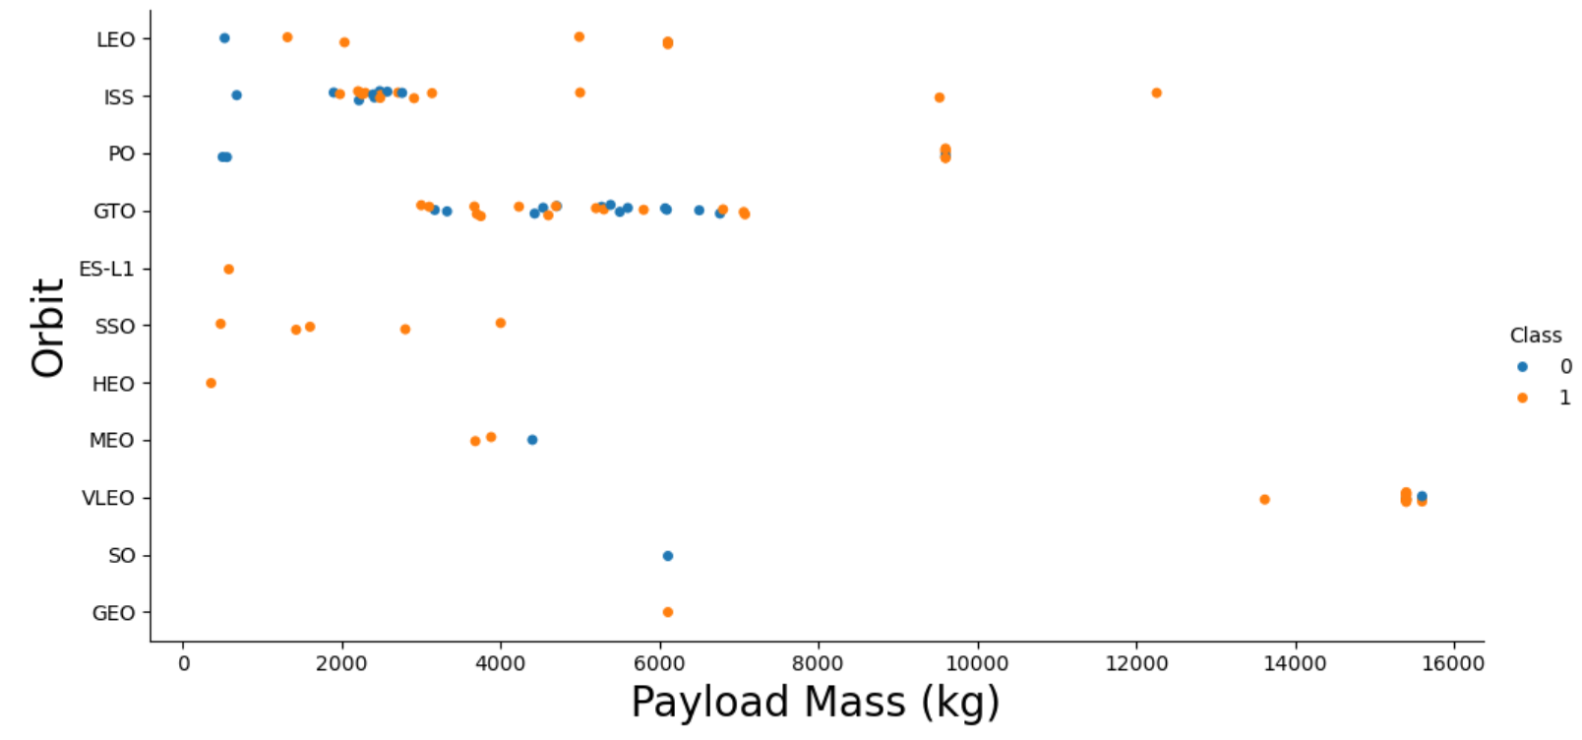
Payload vs. Orbit Type
For Polar, LEO and ISS, the success rates increases with heavier payloads
However, this trend does not apply to all orbits

Slide 23
Launch Success Yearly Trend
The success rate increased drastically between 2013 and 2017
In 2018, the success rate dropped by around 20%
In 2020, the success rate was higher than 80%

Slide 24
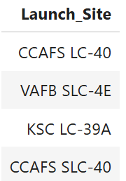
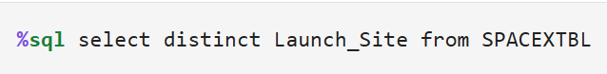
All Launch Site Names
There are four unique launch sites in the space mission
CCAFS LC-40
VAFB SLC-4E
KSC LC-39A
CCAFS SLC-40

Slide 25
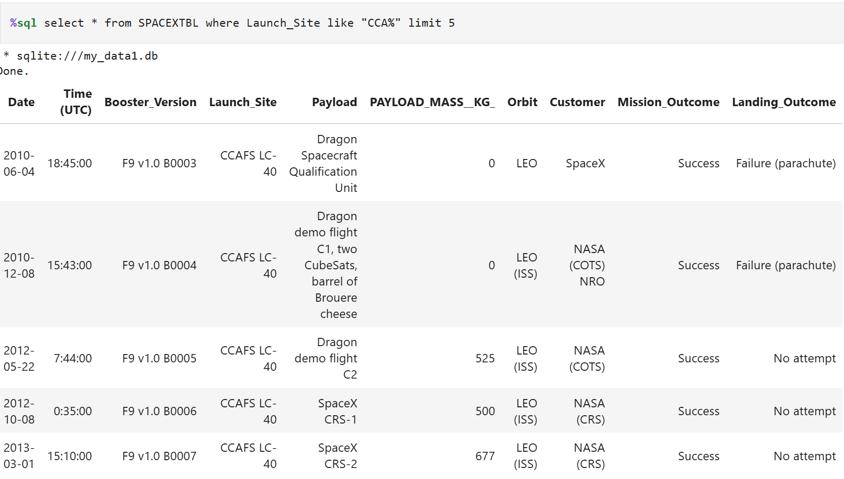
Launch Site Names Begin with 'CCA'

Slide 26
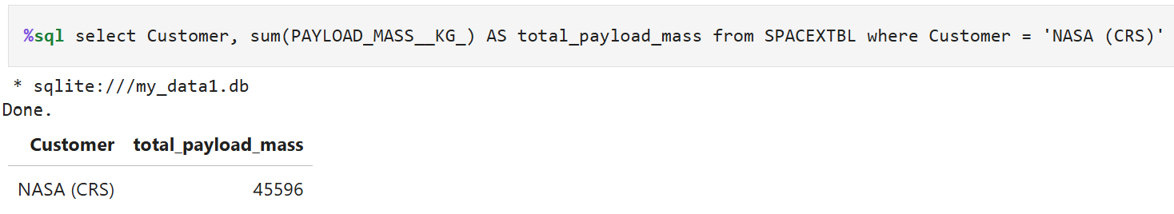
Total Payload Mass
The total payload carried by boosters from NASA is 45.596 kg

Slide 27
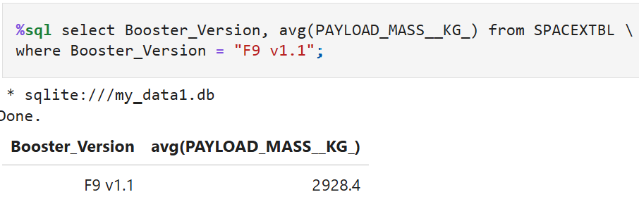
Average Payload Mass by F9 v1.1
The average payload mass carried by booster version F9 v1.1 is 2.928,4 kg

Slide 28
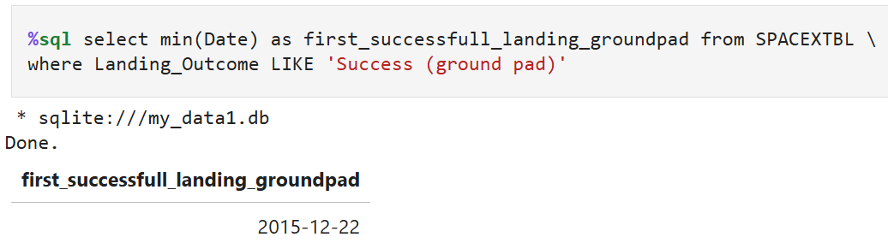
First Successful Ground Landing Date
2015-12-22: first successful landing outcome on ground pad

Slide 29
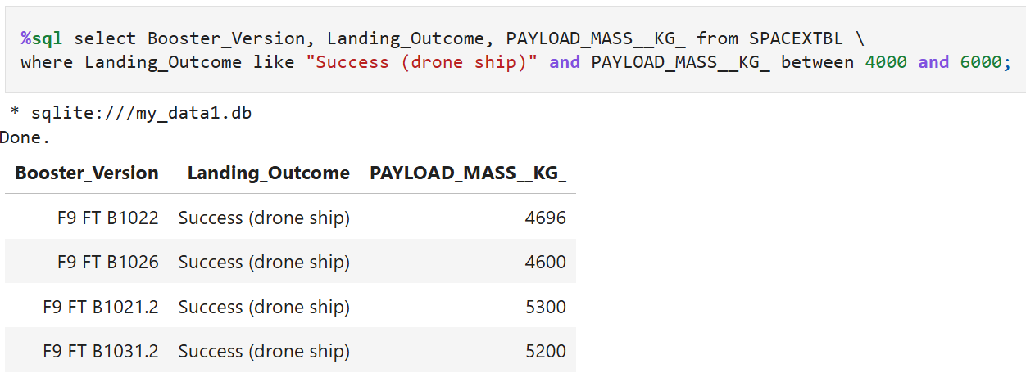
Successful Drone Ship Landing with Payload between 4000 and 6000
Names of boosters which have successfully landed on drone ship and had payload mass greater than 4000 but less than 6000

Slide 30
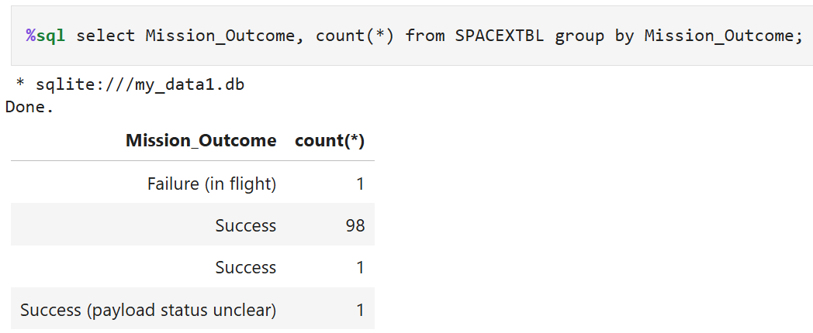
Total Number of Successful and Failure Mission Outcomes
Total number of successful and failure mission outcomes
Success: 99
Success (payload status unclear): 1
Failure: 1

Slide 31
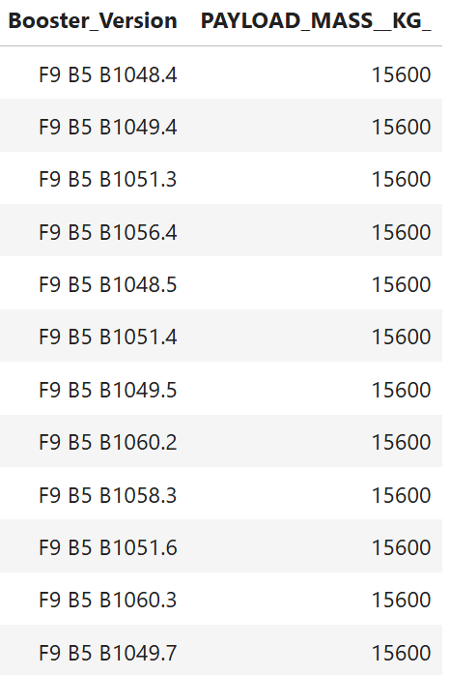
Boosters Carried Maximum Payload
Names of the booster which have carried the maximum payload mass (15.600 kg)

Slide 32
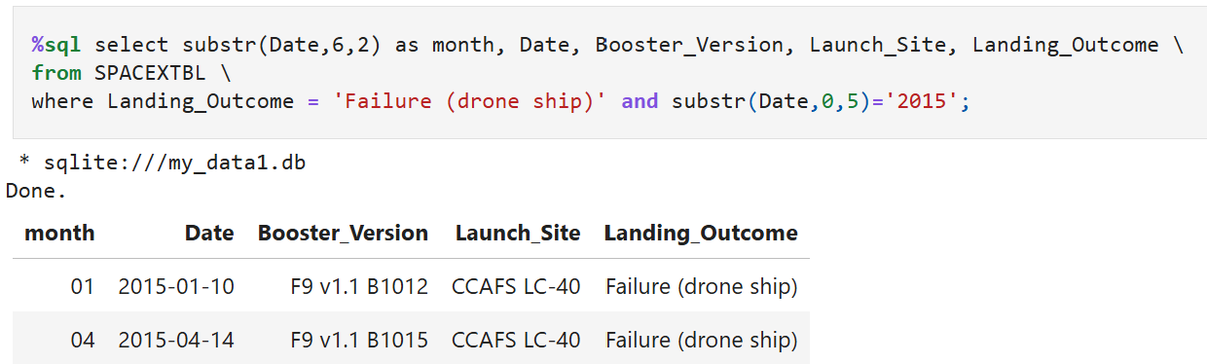
2015 Launch Records
List of failed landing outcomes in drone ship in year 2015

Slide 33
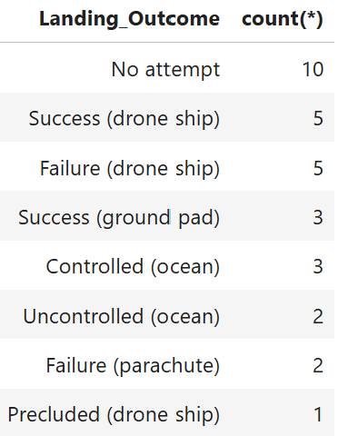
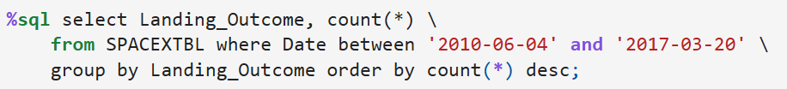
Rank Landing Outcomes Between 2010-06-04 and 2017-03-20
Rank the count of landing outcomes between the date 2010-06-04 and 2017-03-20, in descending order

Slide 34

Section 3

Slide 35
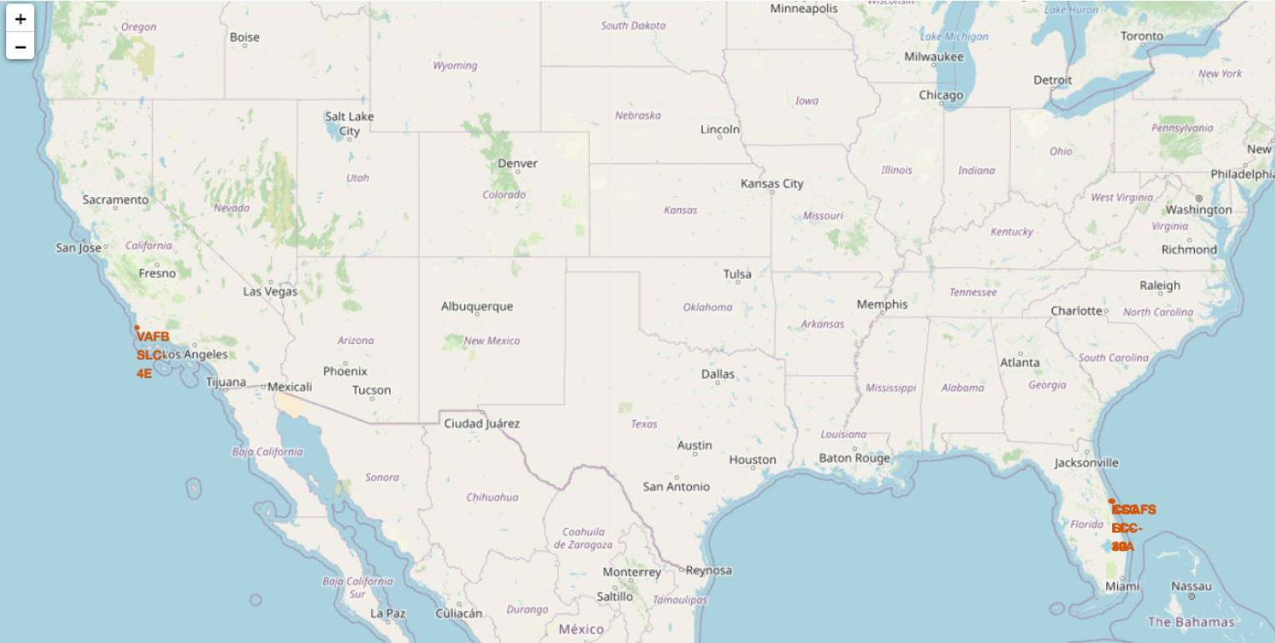
SpaceX Launch Site Locations
Folium map shows the locations of the launch sites
All launch sites are close to a coast in California and Florida
Reduce the risk to populated areas in case of launch failure

Slide 36
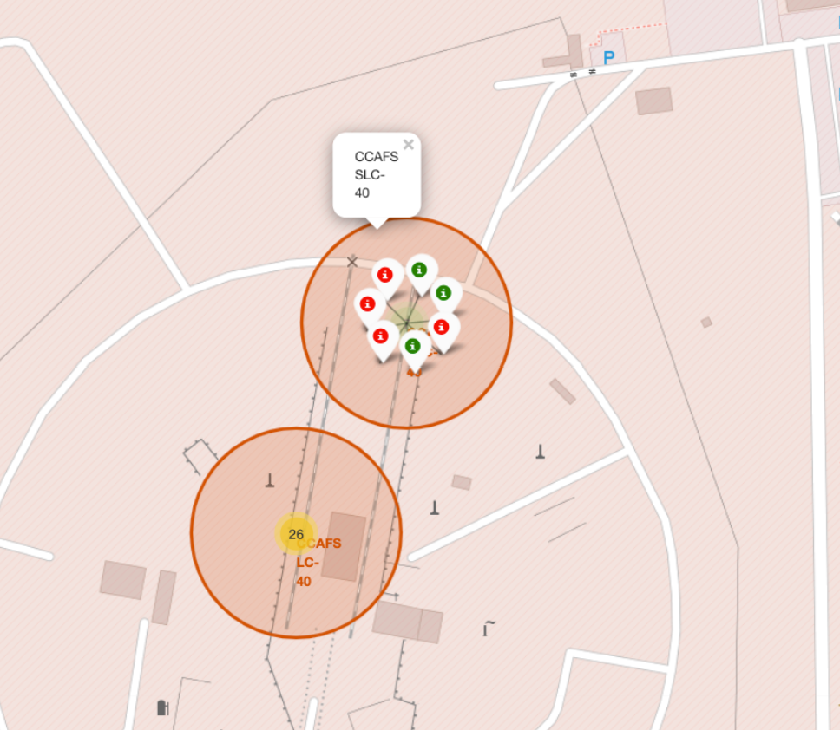
Launch outcomes of CCAFS SLC-40
Folium map shows color-labeled launch outcomes of launch site CCAFS SLC-40 in Florida
Green: successful launches
Red: unsuccessful launches

Slide 37

Explore Proximity of Launch Site
Explore the proximities of launch site AFS SLC-40 in Florida
AFS SLC-40 is in close proximity to a coastline (0.90 km)

Slide 38

Section 4

Slide 39
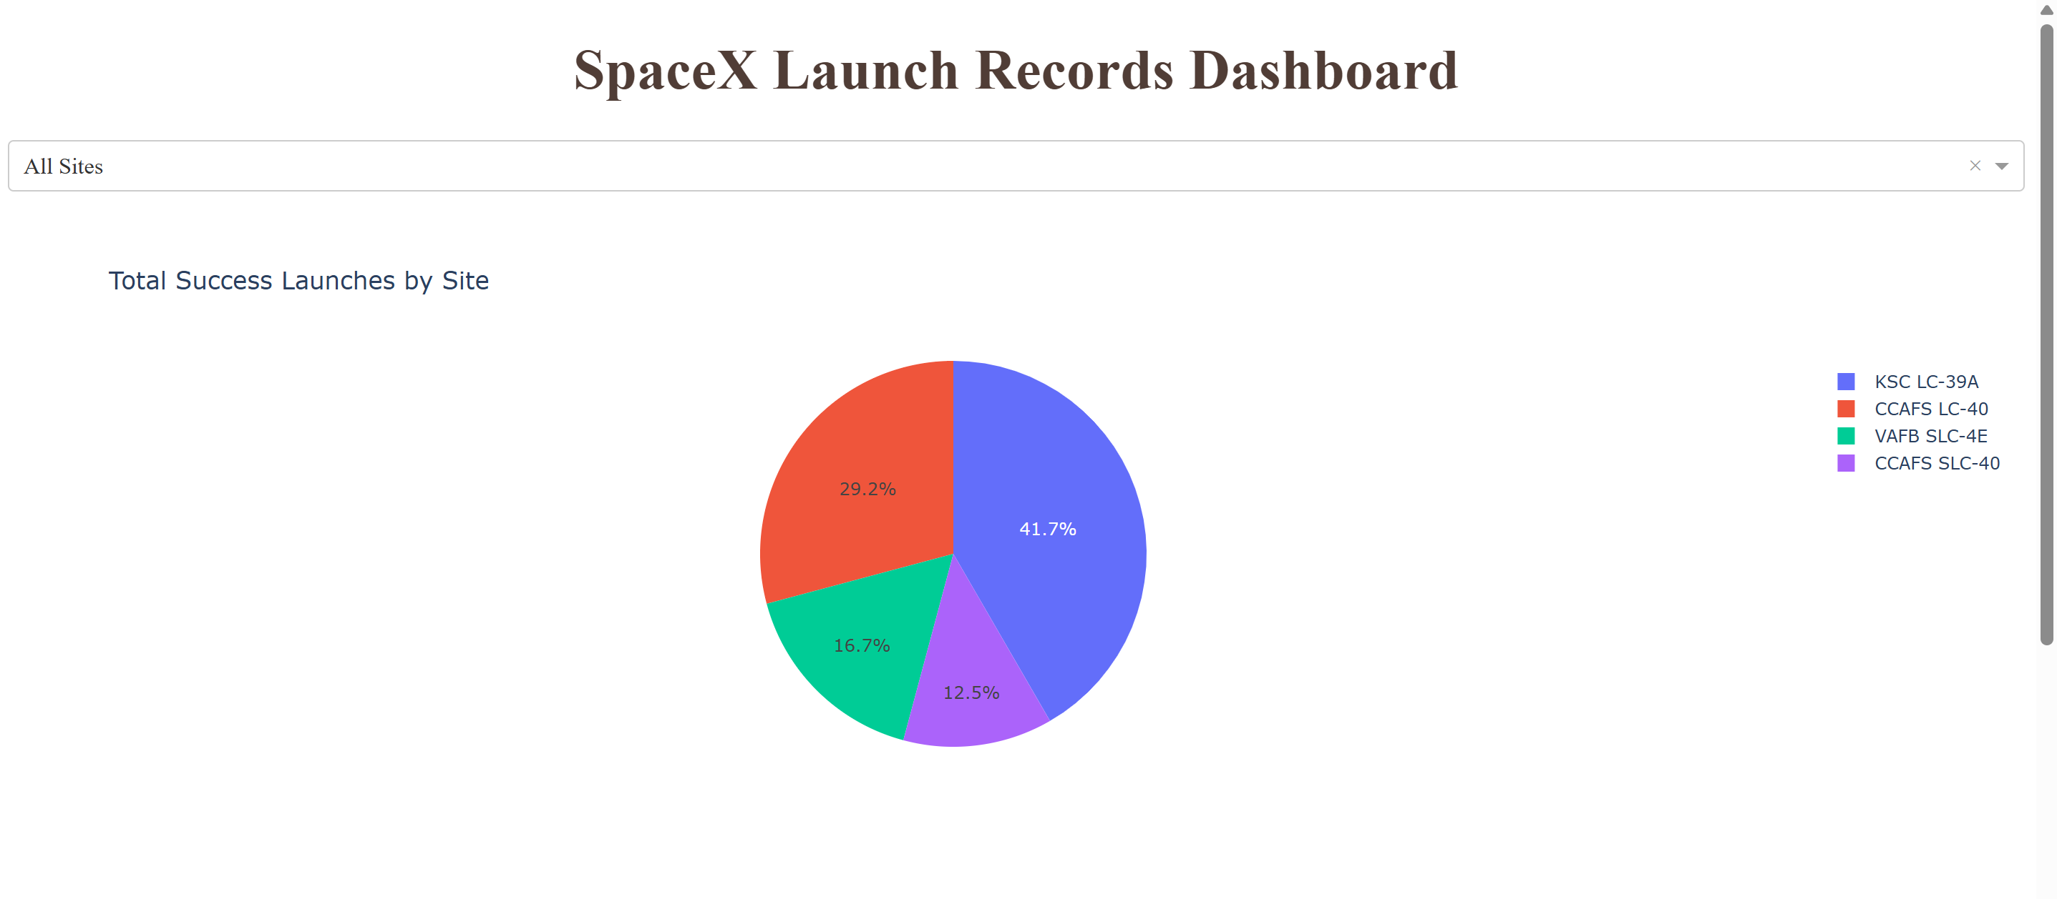
Interactive Dashboard: Successful Landings
Pie chart visualizes launch success count for all sites
Launch site with highest success count: KSC LC-39A
Launch site withl lowest success count: CCAFS SLC-40

Slide 40
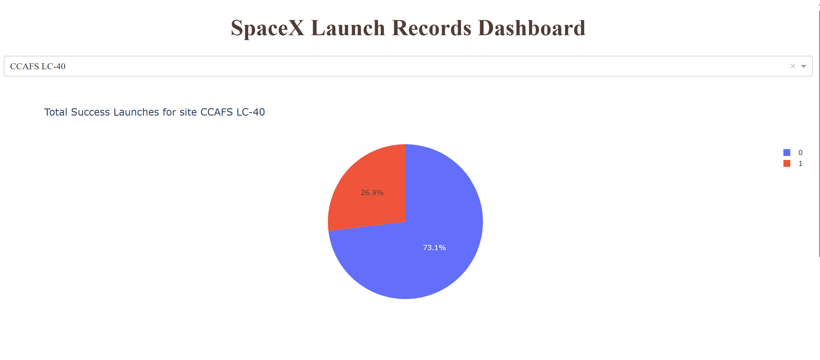
Pie Chart: Launch Success Rate of CCAFS LC-40
Pie Chart visualizes the success ratio of launch site CCAFS LC-40
Unsuccessful launches: 73.1%
Successful launches: 26.9%
CCAFS LC-40 has the lowest success rate among all launch sites (26.9%)
KSC LC-39A has the highest success rate (76.9%)

Slide 41
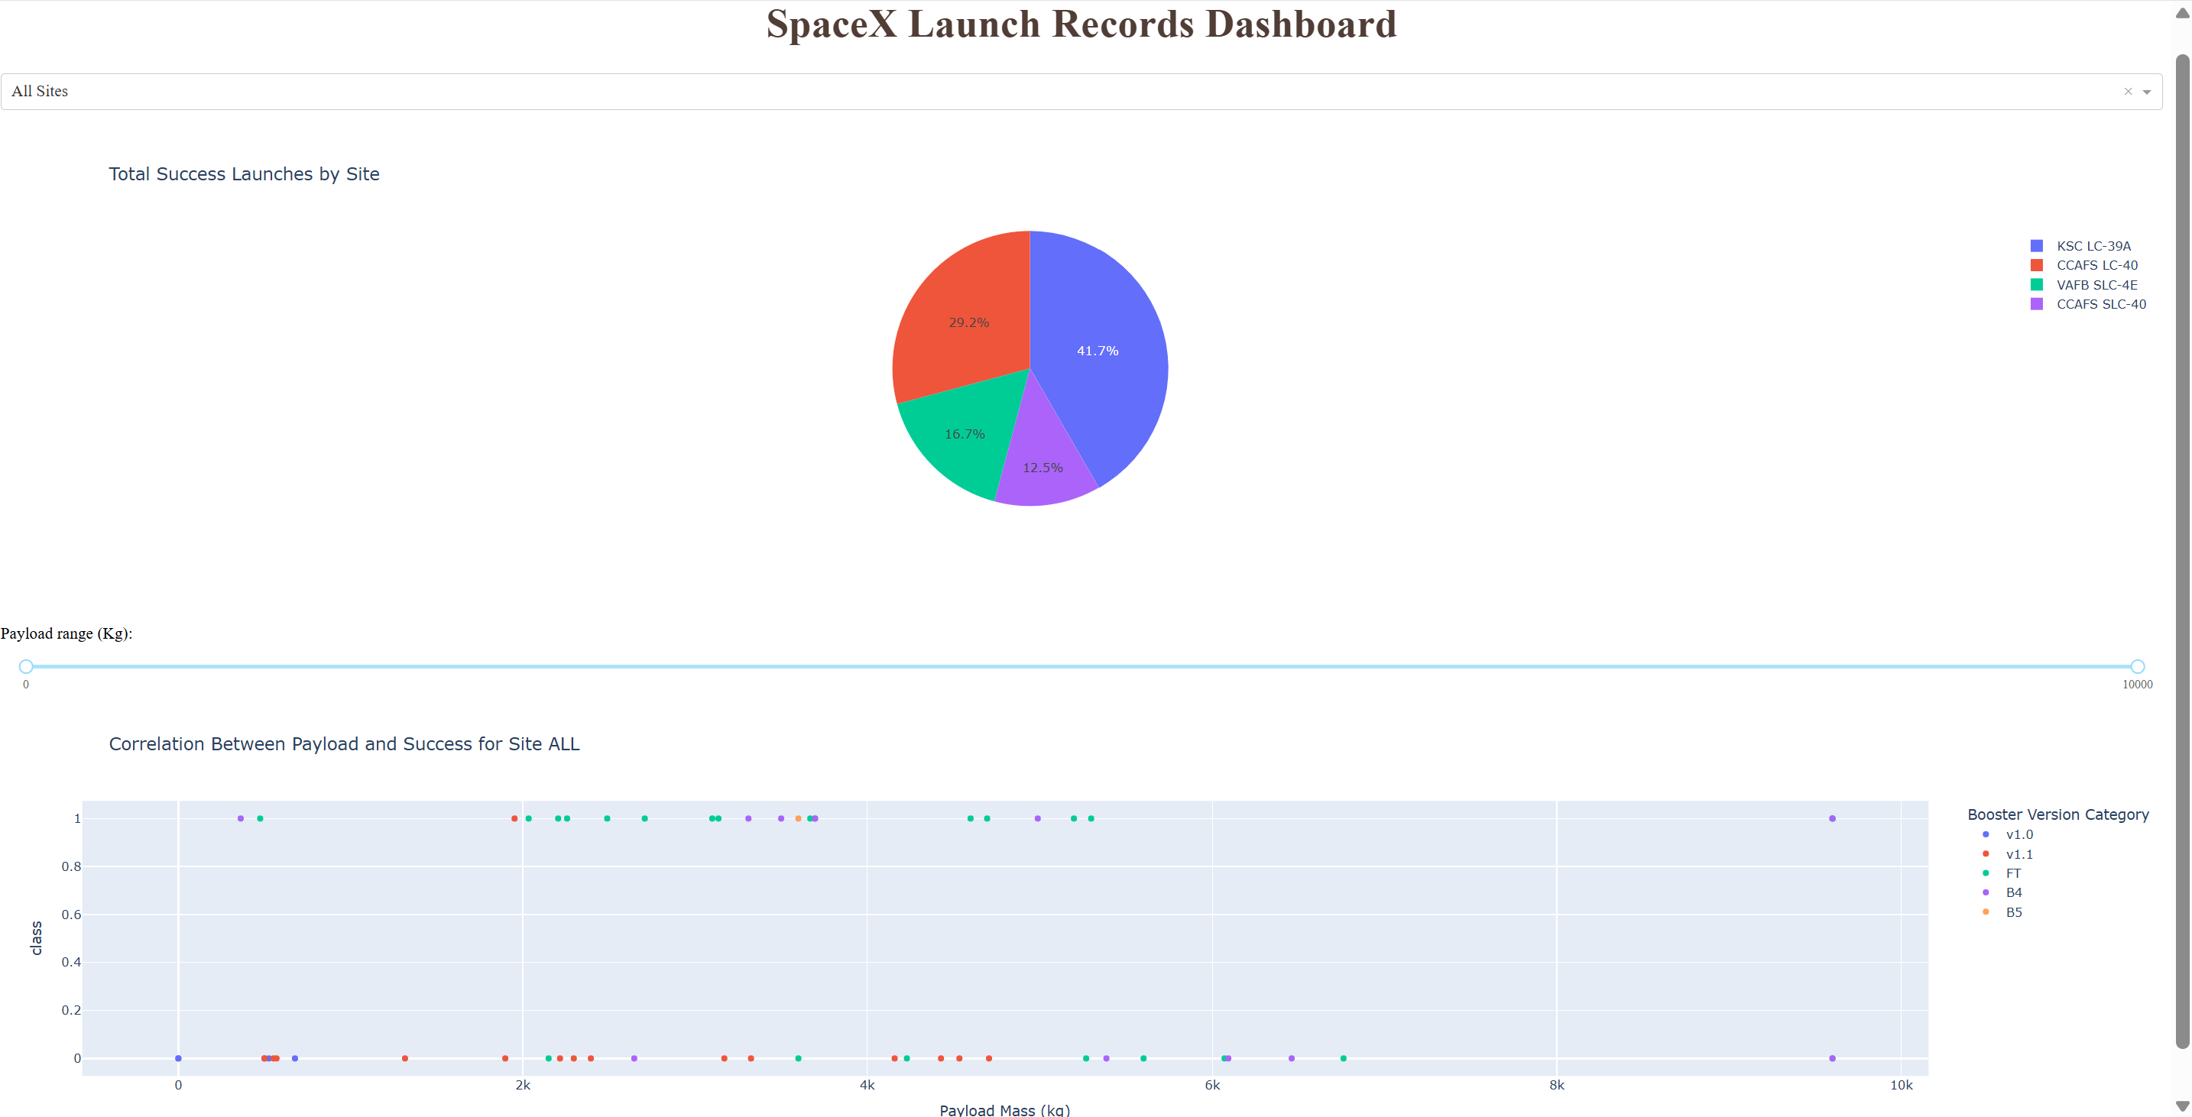
Scatter Plot: Payload vs. Launch Outcome
Scatter plot visualizes the correlation between Payload Mass and Launch Outcome for all sites
The data points are color-labeled based on the booster version category
Booster versions B4 and B5 have the highest success rates
FT boosters have a high success rate for small payloads (< 6000 kg)

Slide 42

Section 5

Slide 43
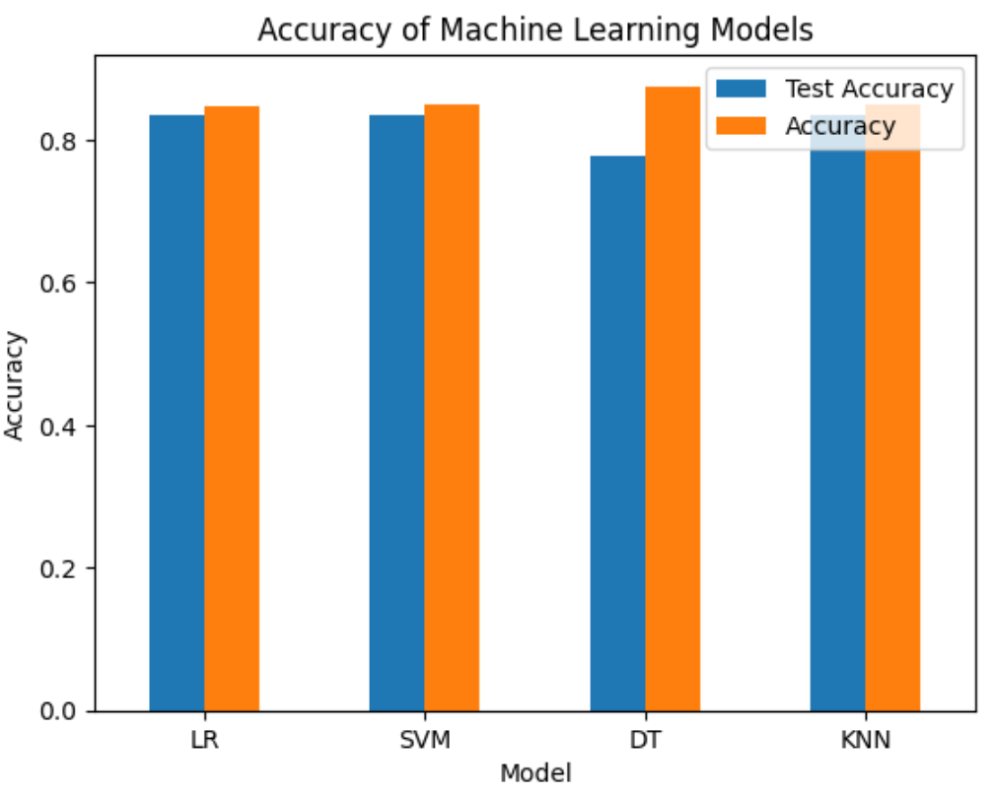
Classification Accuracy
Bar Plot visualizes the test accuracy and the accuracy on the validation data of different machine learning models
The Decision Tree (DT) has the highest accuracy on the validation data (87.5%)
However, the Decision Tree also has the lowest test accuracy (77,8%) of all models
Overall, all models have a similar performance

Slide 44
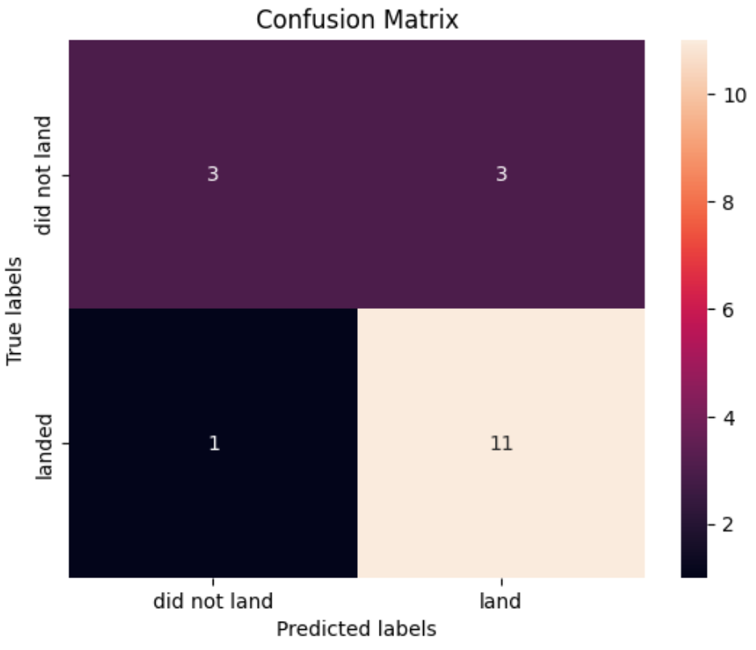
Confusion Matrix
Confusion matrix of DecisionTreeClassifier provides summary of the performance on the test data
True Positives: 11
True Negatives: 3
False Positives: 3
False Negatives: 1

Slide 45
Conclusions
The success rate of rocket launches increased over the last years (2013-2020)
2020: more than 80% of rocket launches were successful
The success rate is influenced by several factors (e.g. orbit, launch site, payload mass)
Launch sites are typically close to the coast near the equator line
We are able to accurately predict the first stage landing outcome with multiple machine learning models

Slide 46
Appendix
Data Sources
SpaceX API (https://api.spacexdata.com/v4/rockets)
Wikipedia page titled List of Falcon 9 and Falcon Heavy launches (https://en.wikipedia.org/wiki/List_of_Falcon_9_and_Falcon_Heavy_launches)
Link to GitHub repository: GitHub-Repository

Slide 47


